Slide 1
Makers
and
Creators
Notes:
Welcome everyone to this week of makers and creators at campus north.

Slide 2

Wednesday
Notes:
Today we will be using the raspberry pi to run minecraft, do some building and try changing the world as we move around it.

Slide 3
Introducing…
Notes:
your mentors for today - each say who you are and what you do and what your favourite bit of computer science is.

Slide 5
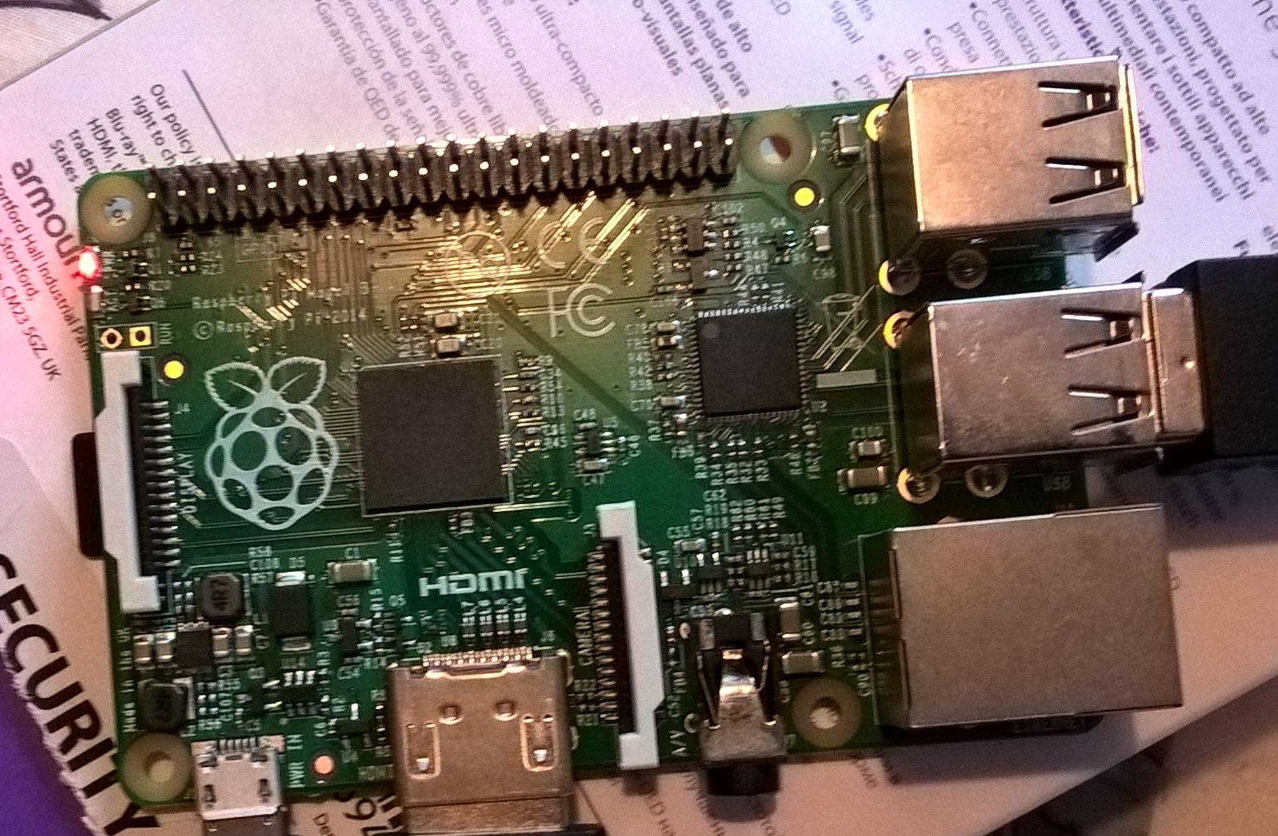

Slide 6
Let’s get connected

Slide 7
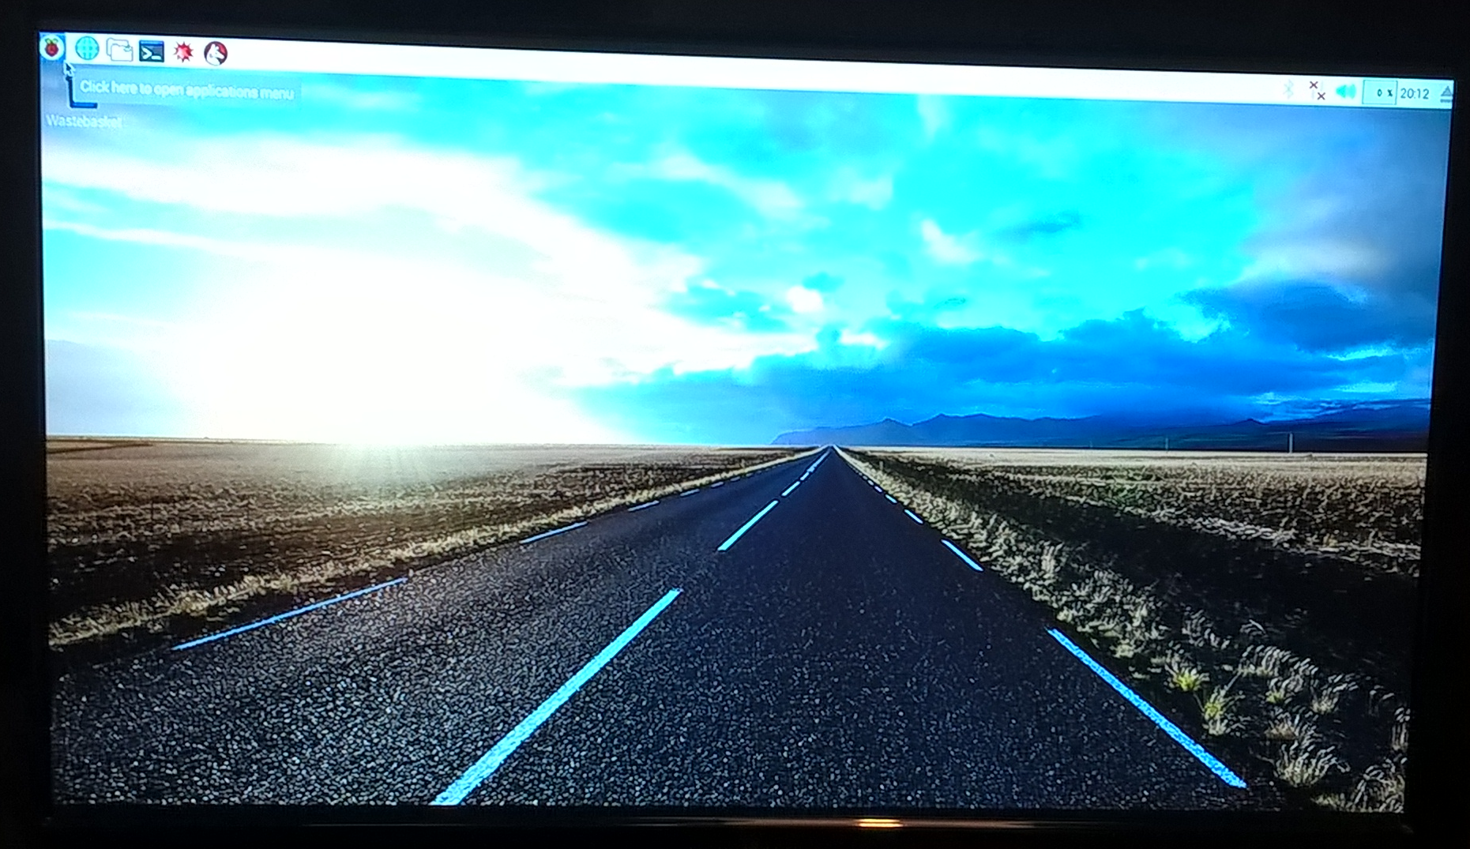

Slide 8
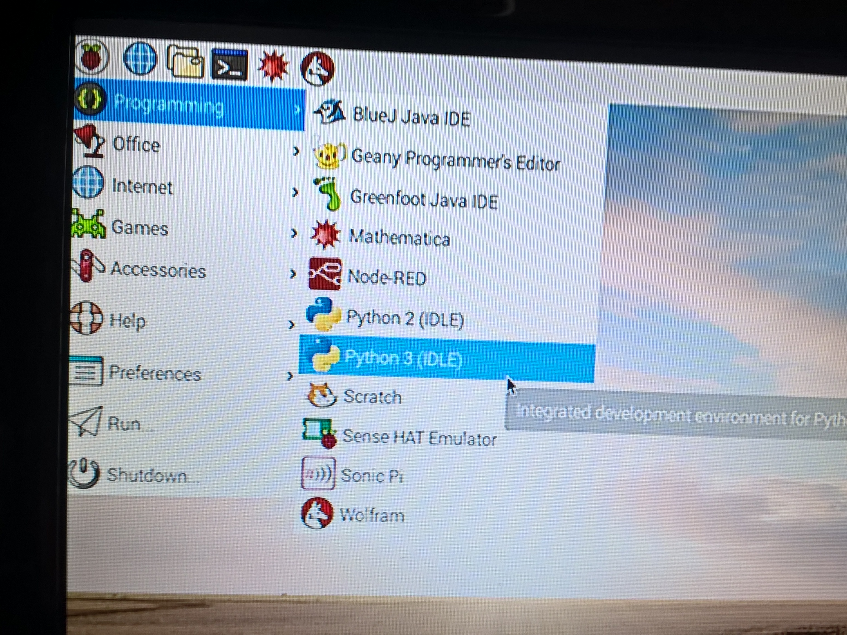

Slide 9
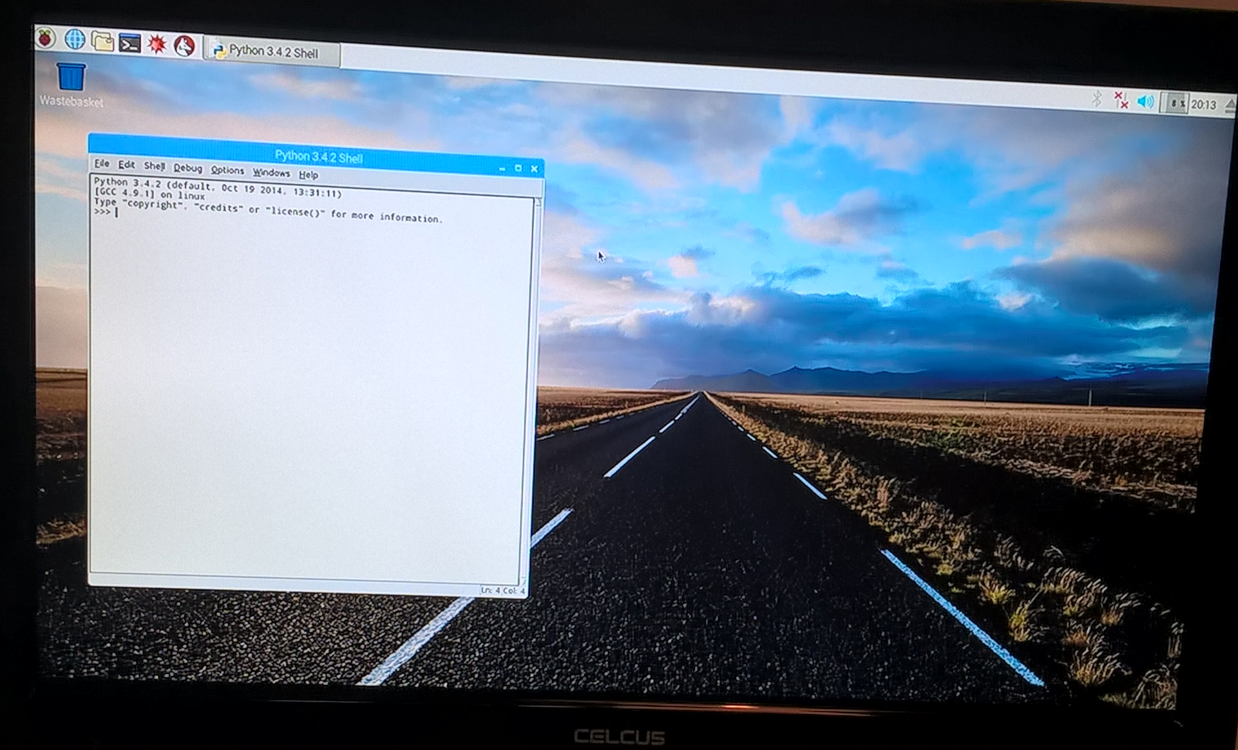

Slide 10
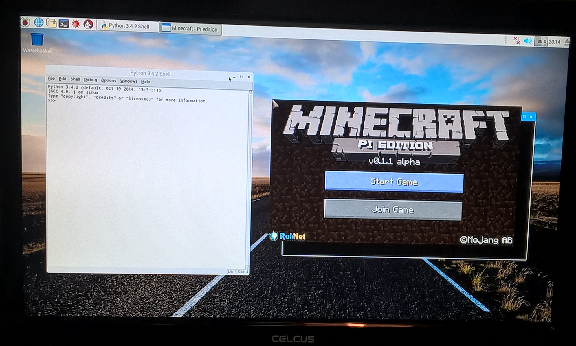

Slide 11
Moving Around
The mouse changes where you look
W, S, A, D move you forward, backward, left, and right
Mouse Left destroys blocks
Mouse Right places blocks
1, 2, 3, 4, 5, 6, 7, 8 change what you are holding
E opens the inventory
ESC takes you back and to the Menu
SPACE is jump & double-tap is fly
TAB lets you leave the game

Slide 12

Notes:
Yesterday working on the insides of minecraft to change things, add different blocks etc.
Who remembers what you did?
This time, we will be running the pi version of minecraft which lets us write scripts to control it from the outside.

Slide 13
Notes:
script running on left, running on right hand side.

Slide 14

Notes:
So let’s open a new file in idle, lets call it hello.py

Slide 15
import mcpi.minecraft as minecraft
world = minecraft.Minecraft.create()
Notes:
Always want this at the top of our programs, might need to add imports.

Slide 16
import mcpi.minecraft as minecraft
world = minecraft.Minecraft.create()
world.postToChat(‘hello’)
Notes:
save and run from menu.
* Change the code to read in a message from the console
* Ask for the player's name and write that out in the message.
* Use a while loop to keep writing messages to the chat window.

Slide 17


Slide 18
Notes:
So let’s open a new file in idle

Slide 19
Where Are You?

Slide 20
import mcpi.minecraft as minecraft
world = minecraft.Minecraft.create()
x, y, z = world.player.getPos()
Notes:
How far can you move around?
How do you know where you are?
Random position
import random
random.randint(256)

Slide 21
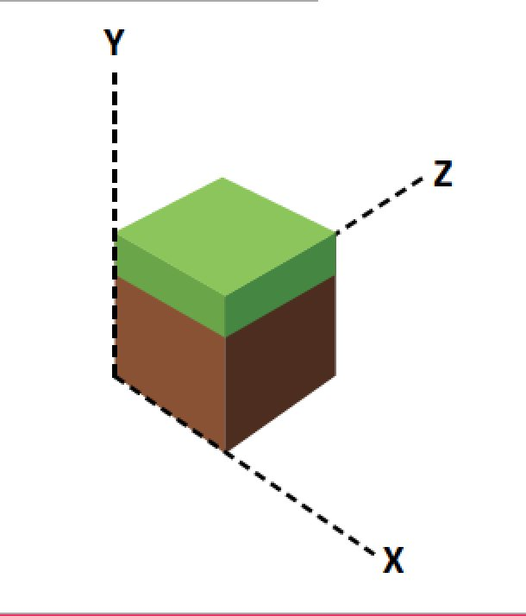
Notes:
x to left and right, y is up in air, z is forward and back
Instead of always moving to one position, move the player a distance (100 blocks?) away from their current position in x, y or z
Move the player a random distance.

Slide 22
Teleport!

Slide 23
import mcpi.minecraft as minecraft
world = minecraft.Minecraft.create()
x = 10
y = 20
z = 30
world.player.setPos(x, y, z)
Notes:
How far can you move around?
How do you know where you are?
Random position
import random
random.randint(256)

Slide 24
Random!

Slide 25
import mcpi.minecraft as minecraft
import random
world = minecraft.Minecraft.create()
x = random.randrange(-128, 128)
y = random.randrange(0, 64)
z = random.randrange(-128, 128)
world.player.setPos(x, y, z)
Notes:
x = random.randrange(3, 10)

Slide 26
import mcpi.minecraft as minecraft
import random
import time
world = minecraft.Minecraft.create()
while True:
x = random.randrange(-128, 128)
y = random.randrange(0, 64)
z = random.randrange(-128, 128)
world.player.setPos(x, y, z)
time.sleep(5)
Notes:
Let’s teleport somewhere random every 5 seconds

Slide 27

Notes:
Who has seen frozen?

Slide 28
import mcpi.minecraft as minecraft
import time
world = minecraft.Minecraft.create()
ice = 79
while True:
time.sleep(0.2)
x, y, z = world.player.getPos()
world.setBlock(x, y - 1, z, ice)
Notes:
What about changing not to ice but to gold or lava?
Change block type always, only if standing on a particular type of block?

Slide 29
import mcpi.minecraft as minecraft
import time
world = minecraft.Minecraft.create()
water = 9
ice = 79
while True:
time.sleep(0.2)
x, y, z = world.player.getPos()
block_below_player = world.getBlock(x, y - 1, z)
if block_below_player == water:
world.setBlock(x, y - 1, z, ice)
Notes:
Change the block type up above.
Change block type always, only if standing on a particular type of block?

Slide 30

Notes:
Now we can change individual blocks, let’s try some building. We’ll. build a column of blocks.

Slide 31
Notes:
X is side to side, z is in and out, y is up and down.

Slide 32
import mcpi.minecraft as minecraft
world = minecraft.Minecraft.create()
x, y, z = world.player.getPos()
for i in range(5):
world.setBlock(x + 3, y + i, z, 1)
Notes:
Let’s build a tower a couple of steps away…

Slide 33


Slide 34
import mcpi.minecraft as minecraft
world = minecraft.Minecraft.create()
x, y, z = world.player.getPos()
for i in range(10):
world.setBlock(x + i, y, z, 4)
Notes:
Let’s lay a line of bricks, stone = 1, grass = 2, soil = 3, wood = 5, cobble stones = 4, tnt = 46, lava = 10

Slide 35
Notes:
Ok we can build along and we can build up. Lets put them together and build a wall.

Slide 36
import mcpi.minecraft as minecraft
world = minecraft.Minecraft.create()
x, y, z = world.player.getPos()
wall_height = 5
wall_length = 10
for i in range(wall_length):
for j in range(wall_height):
world.setBlock(x + i, y + j, z, 4)
Notes:
Let’s try building four walls around us?

Slide 37


Slide 38
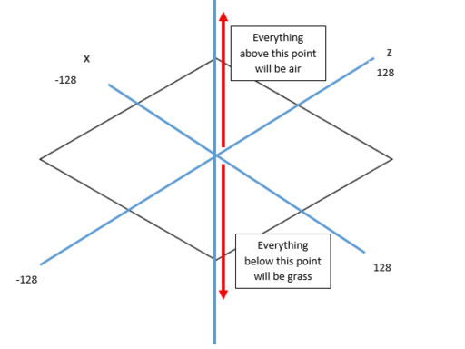

Slide 39
import mcpi.minecraft as minecraft
import mcpi.block as block
world = minecraft.Minecraft.create()
world.setBlocks(-128, -64, -128,
128, 0, 128, block.GRASS)
world.setBlocks(-128, 0, -128,
128, 64, 128, block.AIR)
Notes:
Need to clear the local area.
Notice setBlocks not block. Could make it grass, then soil, then rock?

Slide 40

Notes:
continuing with the gardening theme… lets make a tree. We built a tower earlier on, so lets build it in a different material - wood and leaves

Slide 41
x, y, z = world.player.getPos()
trunk_height = 5
leaf_height = 3
world.setBlocks(x + 1, y, z + 1,
x + 1, y + trunk_height, z + 1,
block.WOOD)
world.setBlocks(x - 1, y + trunk_height,
z - 1, x + 3, y + trunk_height + leaf_height,
z + 3, block.LEAVES)
Notes:
Make some short trees or make a really tall one?

Slide 42
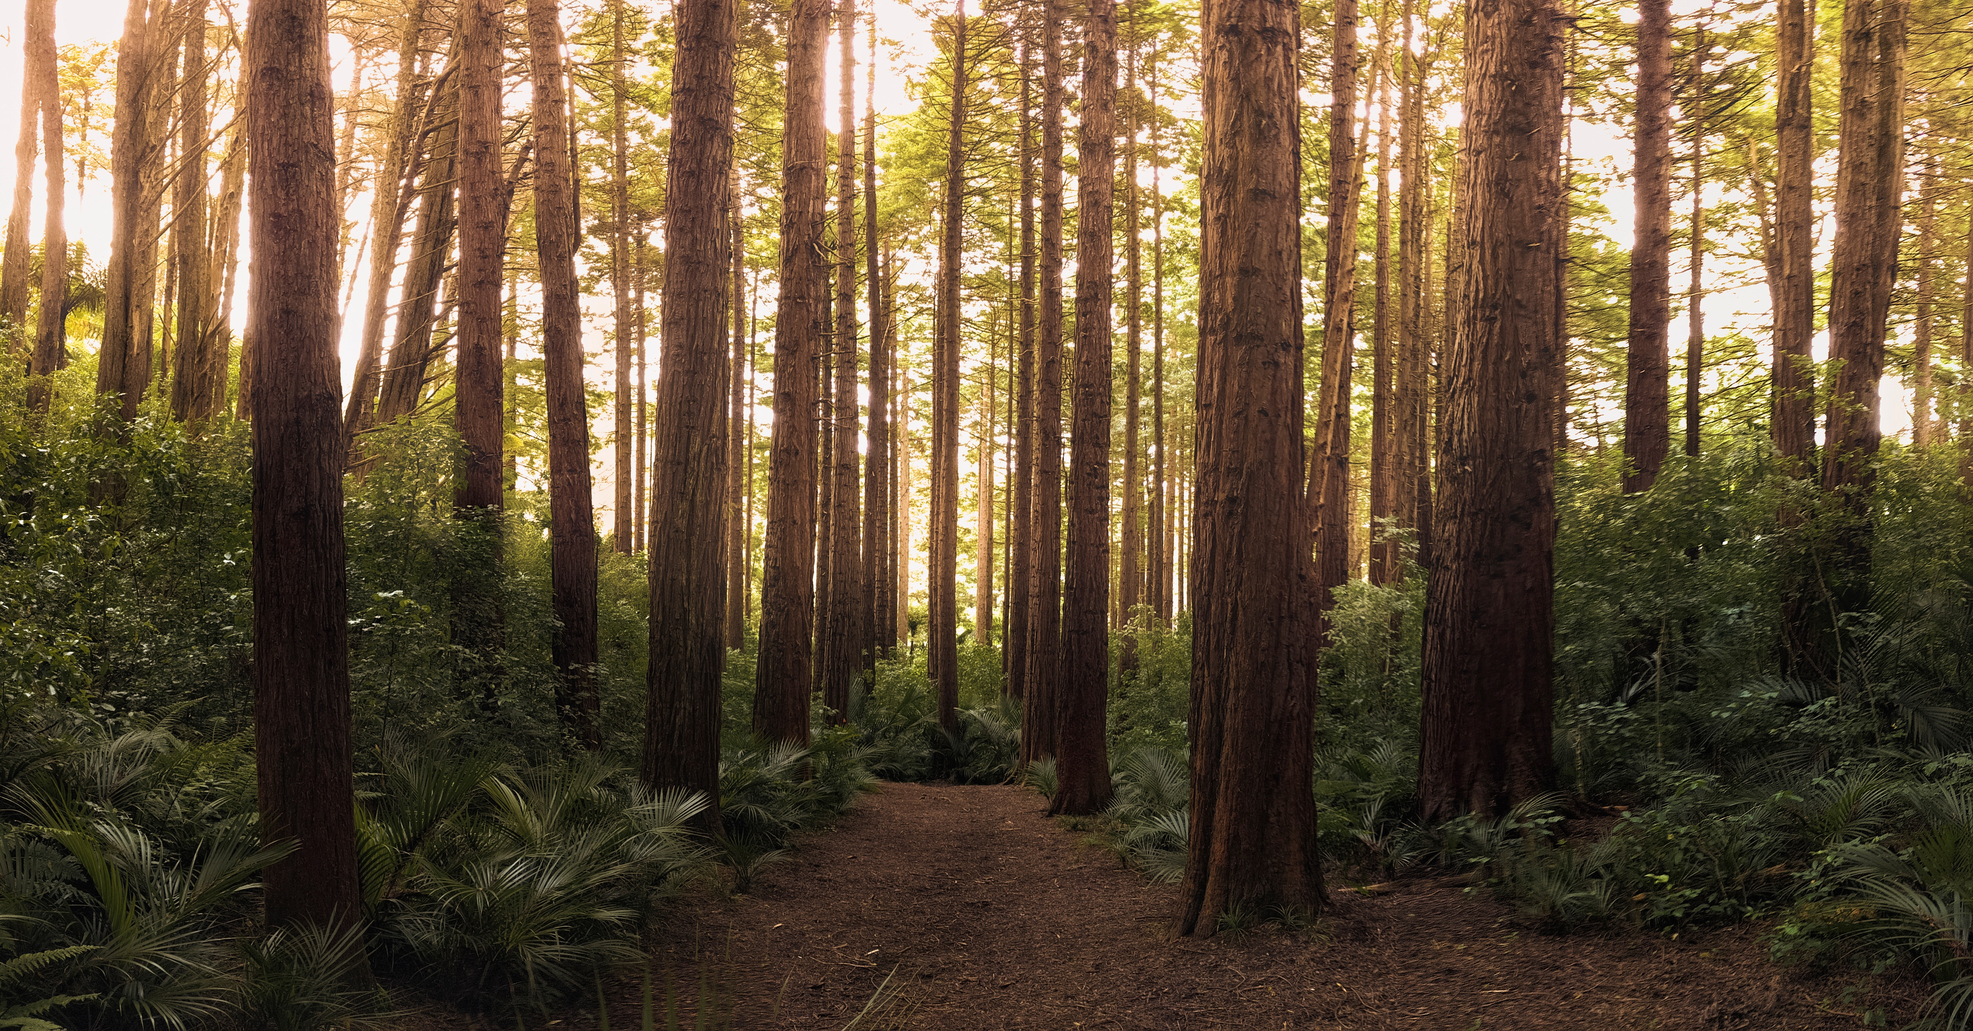
Notes:
How could we make a forest?

Slide 43
Functions
def say_something():
print(‘hi’)
say_something()
Notes:
Reusable chunks of code
Must come first before being used so python sees them and puts them away
Arguments
Return values

Slide 44
Functions
def say_something(message):
print(message)
say_something(‘hey’)
say_something(‘hi’)
say_something(‘hello’)
Notes:
Reusable chunks of code
Arguments
Return values

Slide 45
def build_tree():
x, y, z = world.player.getPos()
trunk_height = 5
leaf_height = 3
world.setBlocks(x + 1, y, z + 1,
x + 1, y + trunk_height, z + 1, block.WOOD)
world.setBlocks(x - 1, y + trunk_height,
z - 1, x + 3, y + trunk_height + leaf_height,
z + 3, block.LEAVES)
world = minecraft.Minecraft.create()
build_tree()
Notes:
Problem is we can still only build one tree. Make a function to do the building. The we can call it from everywhere. Still can’t do it

Slide 46
while True:
time.sleep(1)
build_tree()
Notes:
We can run around a plant trees not ice. Add this to the end of the script and save.

Slide 47
def build_tree(x, y, z):
trunk_height = 5
leaf_height = 3
world.setBlocks(x, y, z,
x, y + trunk_height, z, block.WOOD)
world.setBlocks(x-1,y+trunk_height,
z-1, x+1, y+trunk_height+leaf_height,
z+1, block.LEAVES)
world = minecraft.Minecraft.create()
x, y, z = world.player.getPos()
build_tree(x + 9, y, z + 7)
build_tree(x + 5, y, z + 10)
Notes:
Put them wherever, code changes to put the tree away from the player. Now we can say exactly where we want them.
Random heights - in range. Random positions
trunk = random.randrange(3, 45)
leaves = random.randrange(1, 10)

Slide 48
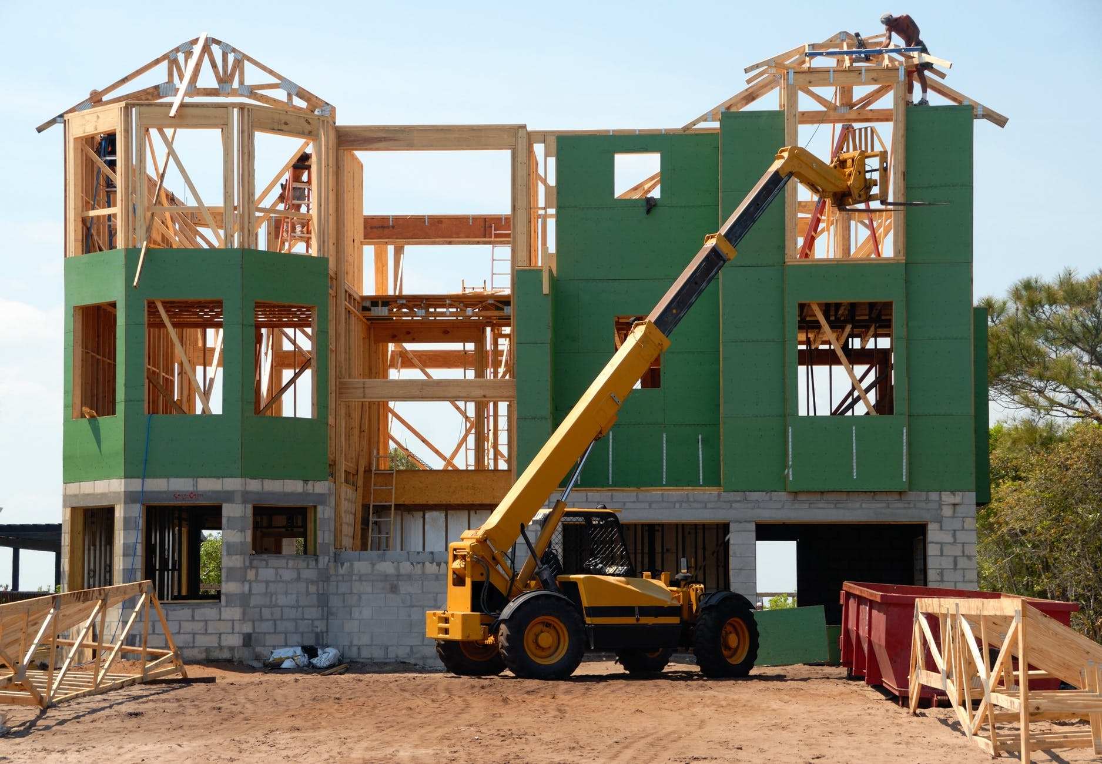
Notes:
You have 5 minutes to build an enclosure that you might want to live in if you were playing the survival version of minecraft.

Slide 49
import mcpi.minecraft as minecraft
import mcpi.block as block
world = minecraft.Minecraft.create()
x, y, z = world.player.getPos()
house_x = x + 5
house_y = y
house_z = z + 5
world.setBlocks(house_x, house_y, house_z,
house_x + 6, house_y + 6, house_z + 6,
block.COBBLESTONE)
Notes:
Let’s build a big block of stone. Try changing the numbers 6 to see what effect that has.

Slide 50
import mcpi.minecraft as minecraft
import mcpi.block as block
world = minecraft.Minecraft.create()
x, y, z = world.player.getPos()
house_x = x + 5
house_y = y
house_z = z + 5
world.setBlocks(house_x, house_y, house_z,
house_x + 6, house_y + 6, house_z + 6,
block.COBBLESTONE)
world.setBlocks(house_x + 1, house_y, house_z + 1,
house_x + 5, house_y + 5, house_z + 5, block.AIR)
Notes:
Now let’s hollow out the middle of the block so we can live inside it.
Values need to be just inside the ones we just used

Slide 51
world.setBlock(house_x + 3, house_y, house_z,
block.AIR)
world.setBlock(house_x + 3, house_y + 1, house_z,
block.AIR)
Notes:
It’s not much good if we can’t get into our new home, so let’s make a door.

Slide 52
world.setBlock(house_x + 3, house_y, house_z,
block.AIR)
world.setBlock(house_x + 3, house_y + 1, house_z,
block.AIR)
world.setBlock(house_x + 1, house_y + 5, house_z,
block.GLASS)
Notes:
And it would be nice to have a window.
Add some more windows to make it a bit lighter

Slide 53
def build_house(x, y, z):
world.setBlocks(x, y, z,
x + 6, y + 6, z + 6,
block.COBBLESTONE)
world.setBlocks(x + 1, y, z + 1,
x + 5, y + 5, z + 5, block.AIR)
world.setBlock(x + 3, y, z,
block.AIR)
world.setBlock(x + 3, y + 1, z,
block.AIR)
world.setBlock(x + 1, y + 5, z,
block.GLASS)
build_house(10, 0, 40)
build_house(20, 0, 40)
build_house(30, 0, 40)
Notes:
Could we make a house function?
So we could make a street of houses,
size always has to be the same?
We could make them all out of random shapes and materials.

Slide 54

Notes:
What about putting a roof on each house - we can do that in one place and all the houses get a roof. Use setBlocks, x, y + height + 1, z, x + width, y + height. + 2, z + length)

Slide 55
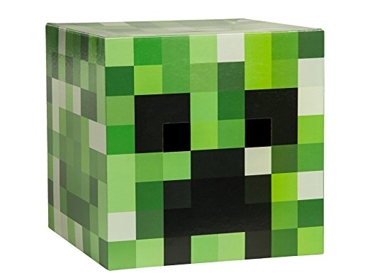
Notes:
In survival mode, creeper tries to kill you if you aren’t protected by a house. We don’t have them in pi minecraft, so we can simulate it with a script.

Slide 56
from mcpi import minecraft
import time
import random
world = minecraft.Minecraft.create()
bedrock = 7
air = 0
blockSpeed = 1.75
x, y, z = world.player.getTilePos()
blockX = x
blockZ = z
blockY = y + 10
time.sleep(3)
Notes:
part 1

Slide 57
while True:
x, y, z = world.player.getTilePos()
world.setBlock(blockX, blockY, blockZ, air)
if x > blockX:
blockX = blockX + 1
elif x < blockX:
blockX = blockX - 1
if y > blockY:
blockY = blockY + 1
elif y < blockY:
blockY = blockY - 1
if z > blockZ:
blockZ = blockZ + 1
elif z < blockZ:
blockZ = blockZ - 1
world.setBlock(blockX, blockY, blockZ, bedrock)
time.sleep(1 / blockSpeed)
Notes:
part 2 - work it’s way closer to you. Can’t move block so we have to erase it where it was, recreate in new place..

Slide 58
Notes:
How could we make that better? Faster approach? camouflage? Game over?
It could be friendly. Block send you messages if you get too far away?
Write a function to draw the creeper/friend. The we can make it more complicated.

Slide 59

Thursday
Notes:
Tomorrow we will be looking at microbits again and using their sensors to interact with the world.

Slide 60
Functions
def is_it_bob(name):
return name == “bob”
if is_it_bob(person_name):
display.scroll(‘hi bob’)
Notes:
Reusable chunks of code
Arguments
Return values

